Slide 1


Slide 2

1. Introduction
High Mortality and Incidence
Over 1 million cases in the U.S. annually
200,000-300,000 deaths before hospital arrival
Risk Factors
Chronic stress
Irregular and unbalanced nutrition
Prediction and Prevention
Complications are often unpredictable
Timely preventive measures are crucial
Objective
The dataset has the potential to yield valuable insights into the complex factors that contribute to myocardial infarction, and could help inform more effective approaches to preventing and treating this challenging condition.
Notes:
Myocardial Infarction (MI) has a high incidence and mortality rate, particularly in developed countries, with significant deaths occurring before hospital arrival.
Complication Variability: The disease progression varies; while some MI cases are uncomplicated, about half of the patients experience complications that worsen prognosis and can lead to death.
Need for Predictive Measures: Accurate prediction of MI complications is crucial for implementing timely preventive measures, highlighting the need for improved prognostic tools in modern medicine.

Slide 3
2. Dataset
The dataset is composed of 1700 instances and 123 attributes
We can solve different classification problems: 12 features (columns 113-124) we can predict, each one associated with a particular complication.
We can consider 4 possible moments for complication prediction:
Admission to Hospital - Usable Columns: 2-112 (except 93, 94, 95, 100, 101, 102, 103, 104, 105)
End of Day 1 (24 Hours) - Usable Columns: 2-112 (except 94, 95, 101, 102, 104, 105)
End of Day 2 (48 Hours) - Usable Columns: 2-112 (except 95, 102, 105)
End of Day 3 (72 Hours) - Usable Columns: 2-112 (all columns)

Slide 4
Method
Goal:
To Classify the Lethal outcome (cause) (LET_IS) using the given dataset, at the end of third day which means that all input columns are available for the prediction
Data Cleaning &
Exploratory Data Analysis
I - Checking duplicates
Feature Selection
II - Handling Missing Values
III - Rebalancing Data
Model Training
Model Evaluation
Notes:
Lethal Outcome is a critical and clinically significant outcome in the context of myocardial infarction

Slide 5
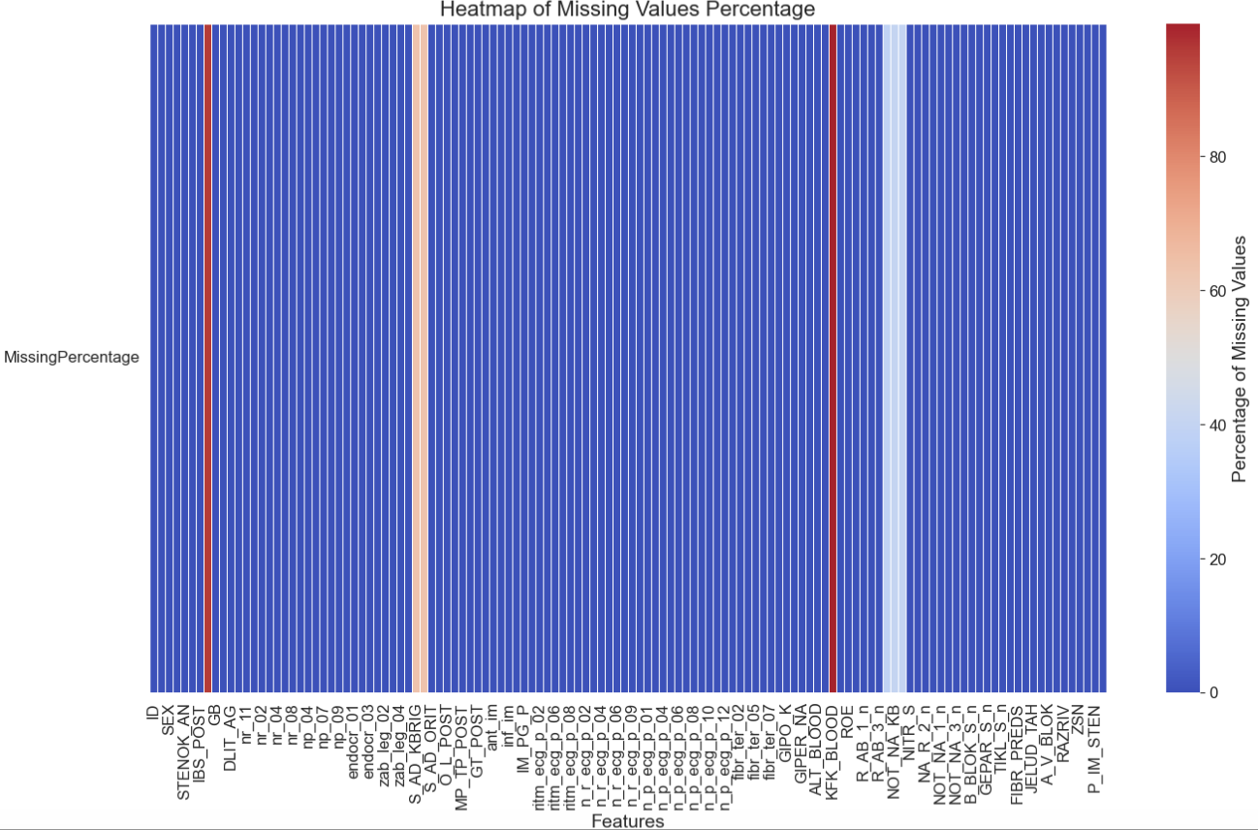
I & II - Duplicates & Missing Values
No duplicate values
We have to deal with the presence of 15974 nan values

Slide 6
II - Missing Values
Remove Columns with over 25% missing values
Mean
Categorical Data
Numerical Data
Ordinal
Binary
KNN
Mode
Notes:
Numerical: the mean (average value) is often used. It provides a central value that helps in maintaining the overall distribution and statistical properties of the data.
mode ( most frequently value )
KNN: replacing missing values with values from the k-nearest neighbors of the instance with the missing data. It leverages the similarity between data points to predict the missing values.
In the code, we choose k = 5, which means that the imputation of a missing value will be based on the average (or majority vote, in case of categorical data) of the 5 nearest neighbors' values

Slide 7
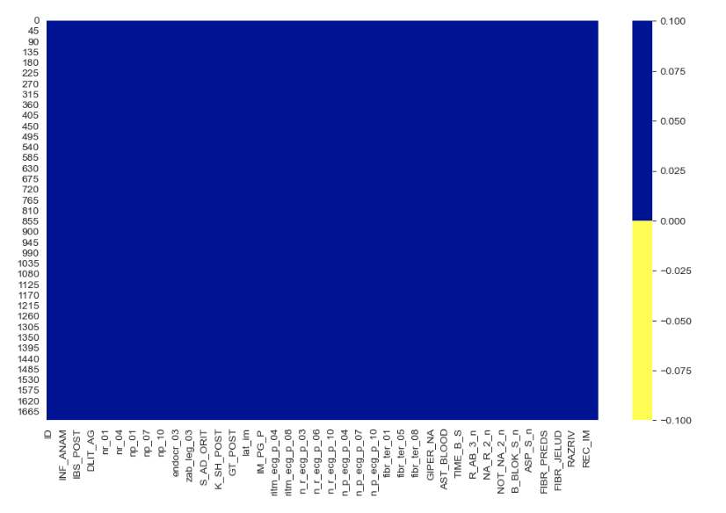
II - Missing Values
The Dataset has no NA value now.

Slide 8
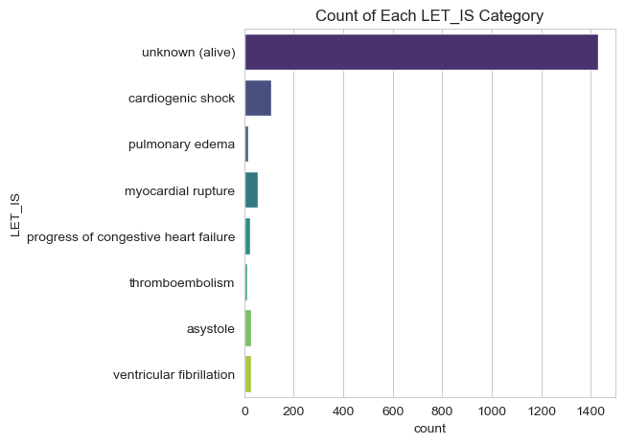
Exploratory Data Analysis
We will re-balance dataset since machine learning classifiers are sensitive to the proportions of classes and fail with imbalanced training datasets
The algorithms tend
to favor the majority obtaining misleading accuracies
IMBALANCED
Notes:
the dataset is unbalanced since the class Unknown outnumbers the other classes. This can cause many problems since machine learning classifiers are sensitive to the proportions of classes and fail with unbalanced training datasets. The algorithms tend to favor the majority obtaining misleading accuracies: we are interested in the correct
classification of the minority class, but we find high accuracies which are the product of the correct classification of the majority class. To solve this problem we will rebalance data

Slide 9
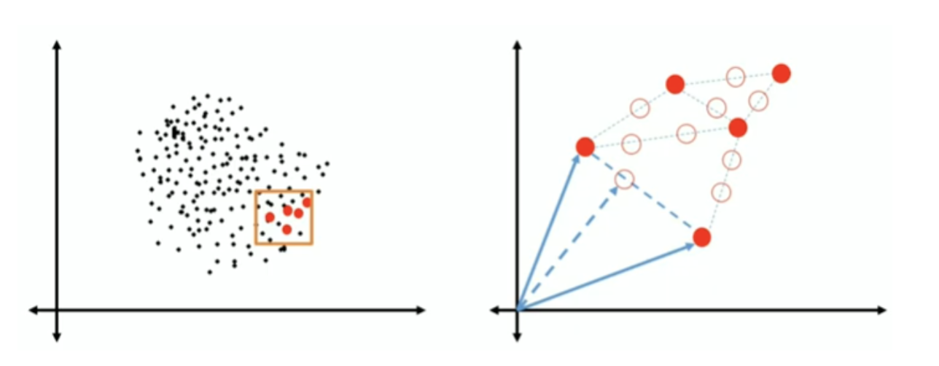
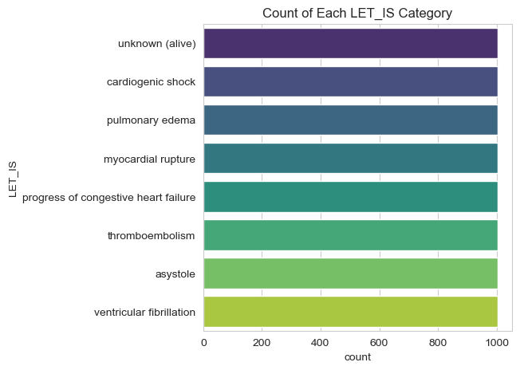
III - Rebalancing data: Synthetic Minority Oversampling Technique
SMOTE is a technique to up-sample the minority classes while avoiding overfitting. It does this by generating new synthetic examples close to the other points (belonging to the minority class) in feature space.
Notes:
We rebalance data in order
to avoid overfitting and wrong predictions, which are often taken considering the majority class

Slide 10
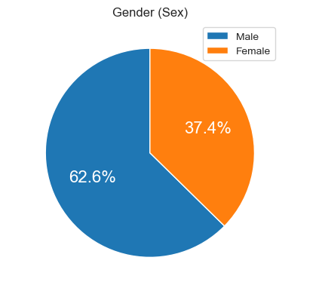
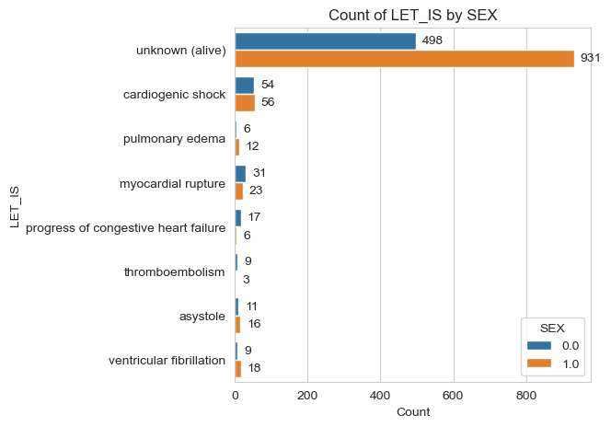
EDA: LET_IS AND GENDER
Higher in males: Alive, pulmonary edema, asystole, ventricular fibrillation.
Higher in females: Myocardial rupture, congestive heart failure, thromboembolism.
Equal in both genders: Cardiogenic shock.
Notes:
We can see that the highest lethal outcome is of unknown (alive) is in the Male while less in Female.
The cardiogenic shock is equally the same in both the Gender.
The pulmonary edema is more in male than the females
The myocardial rupture is more in female than the male
The progress of congestive heart failure and thromboembolism is also more in female than male
And the asystole and ventricular fibrillation is little more in male as comapared to female.

Slide 11
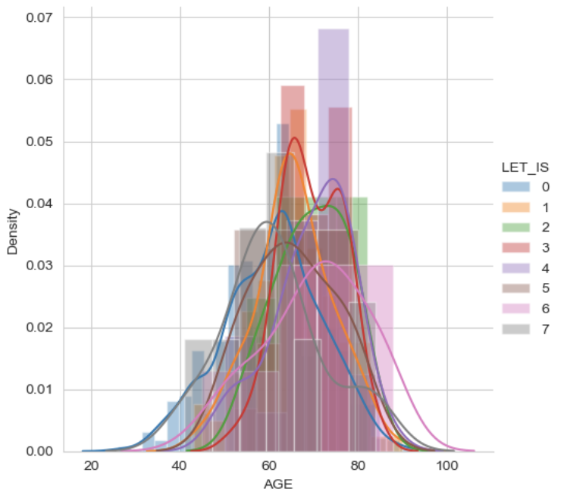
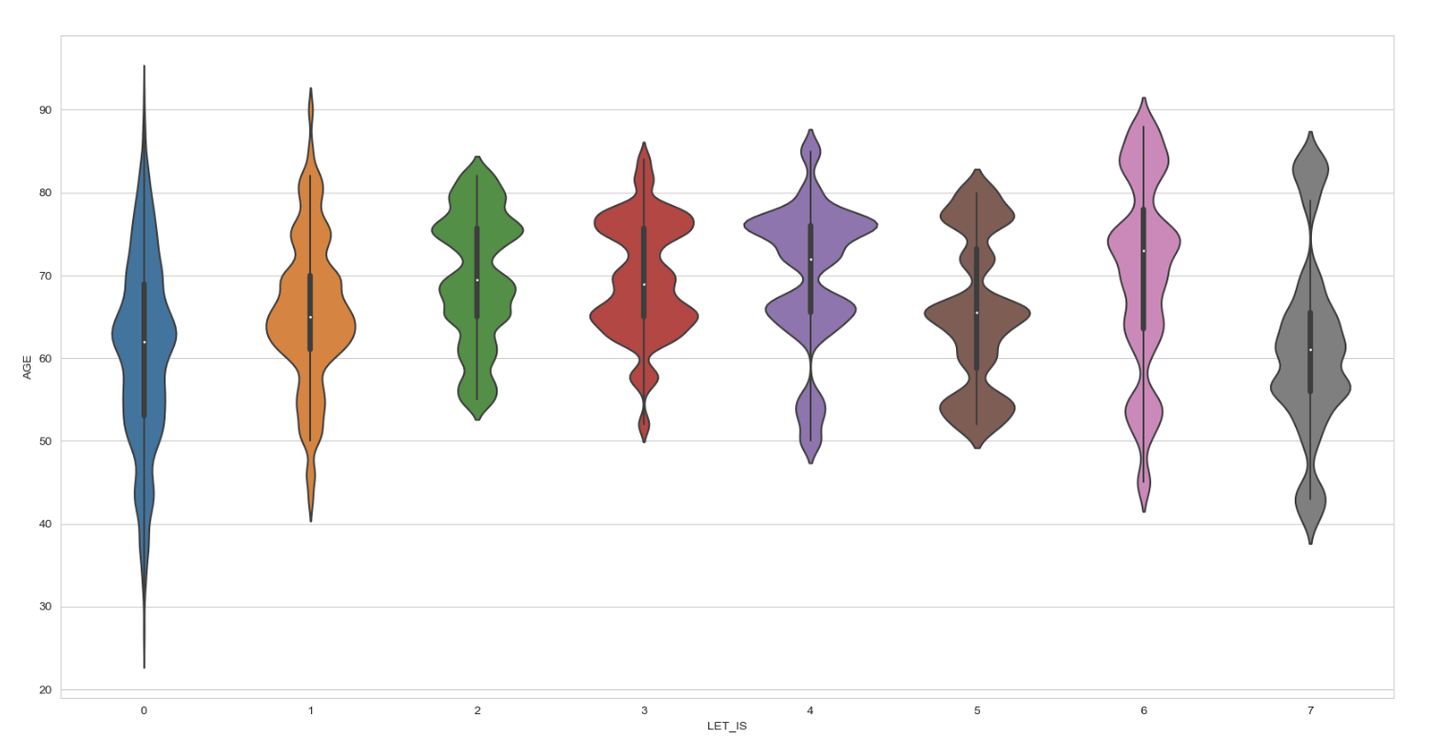
EDA: LET_IS AND AGE
As we can observe maximum Lethal Outcome cause is ranging between 50 to 80
We can observe that myocardial rupture has high peak at the age range between 60 to 80

Slide 12
4. Feature Selection
Goal:
Filter out the irrelevant or redundant variables given the ones already selected and select only the ones providing collectively unique information
Improves Model Performance: Enhances accuracy and efficiency.
Reduces Overfitting: Decreases the risk of capturing noise.
Reduces Computational Cost: Lowers computational requirements.
Method:
Recursive Feature Elimination
Correlation Heatmap
Notes:
By removing irrelevant and redundant features, the “job” of the modeling algorithm is getting easier and thus often leads to better final models.
it helps to reduce feature extracting time as well

Slide 13
Recursive Feature Elimination
Train model
Calculate feature importance
Remove feature least important
Compute accuracy of subset of features
No
desired number of features reached
Initial Training and Ranking: Train the estimator on the initial set of features and obtain the importance of each feature using specific attributes or callable methods.
Recursive Elimination: Recursively prune the least important features from the current set and repeat the process until reaching the desired number of selected features.
Yes
End
Notes:
they concluded with the features that are important to reduce crime- “problem statement”

Slide 14
Correlation Heatmap
METHOD:
Calculate correlation degree between any pair of features to cluster groups of correlated ones then keep only one feature and remove the remaining in each group. 0.85 is used as a threshold

Slide 15
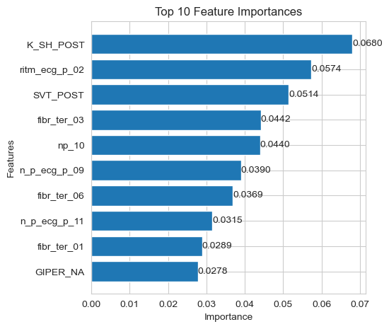
Important Features
Cardiogenic shock at the time of admission to intensive care unit
ECG rhythm at the time of admission to hospital – atrial fibrillation
Paroxysms of supraventricular tachycardia at the time of admission to intensive care unit, (or at a pre-hospital stage)
Fibrinolytic therapy by Сеliasum 3m IU
Complete RBBB in the anamnesis

Slide 16
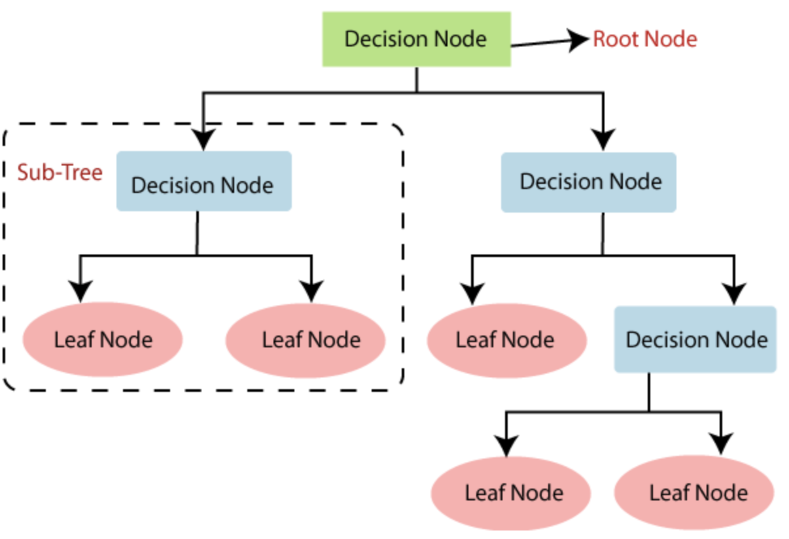
5. Model Training: Decision Tree
select best attribute using ASM (Attribute Selection Measures) to split records.
Information Gain
Gain ratio
Gini index
make the attribute a decision node and break datasets into smaller subsets.
repeat process recursively until:
all tuples belong to same attribute
no more attributes remaining
no more instances.
Notes:
A decision tree in machine learning is a model that splits data into branches based on feature values to make decisions or predictions. It starts with a root node, where the data is divided based on the most significant feature, and this process continues, creating internal nodes and leaf nodes representing outcomes.

Slide 17
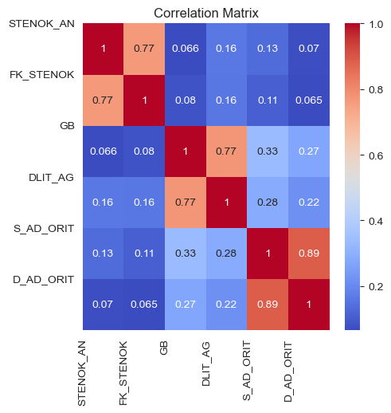
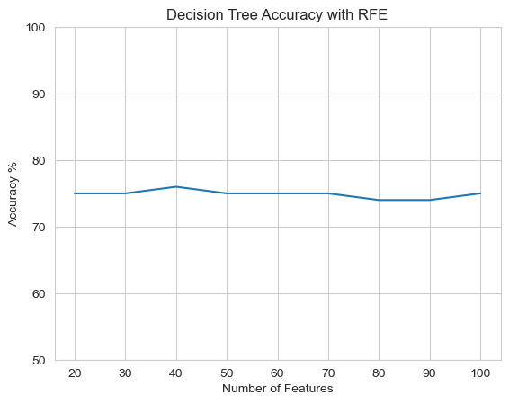
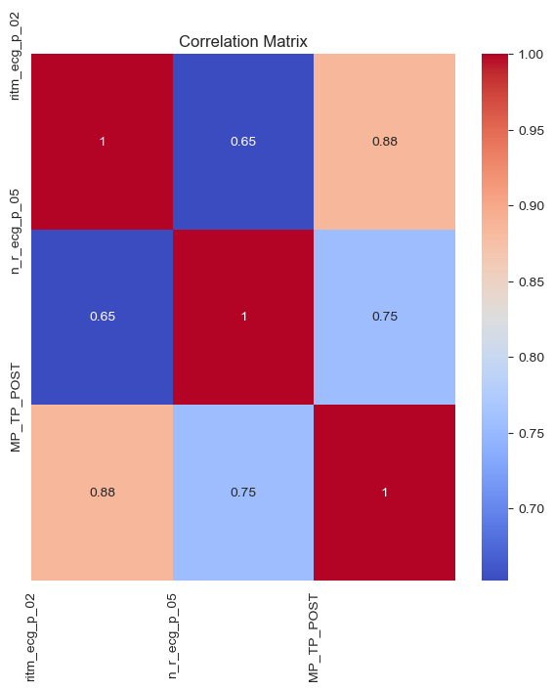
Feature Selection: RFE

Slide 18
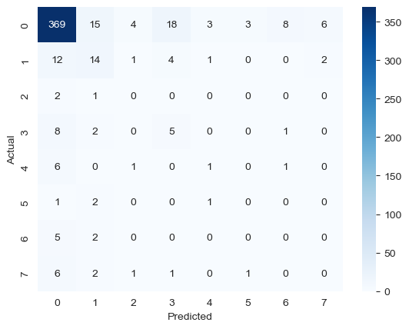
Model Evaluation
precision recall f1-score support
0 0.90 0.87 0.88 426
1 0.37 0.41 0.39 34
2 0.00 0.00 0.00 3
3 0.18 0.31 0.23 16
4 0.17 0.11 0.13 9
5 0.00 0.00 0.00 4
6 0.00 0.00 0.00 7
7 0.00 0.00 0.00 11
accuracy 0.76 510
macro avg 0.20 0.21 0.20 510
weighted avg 0.79 0.76 0.77 510

Slide 19
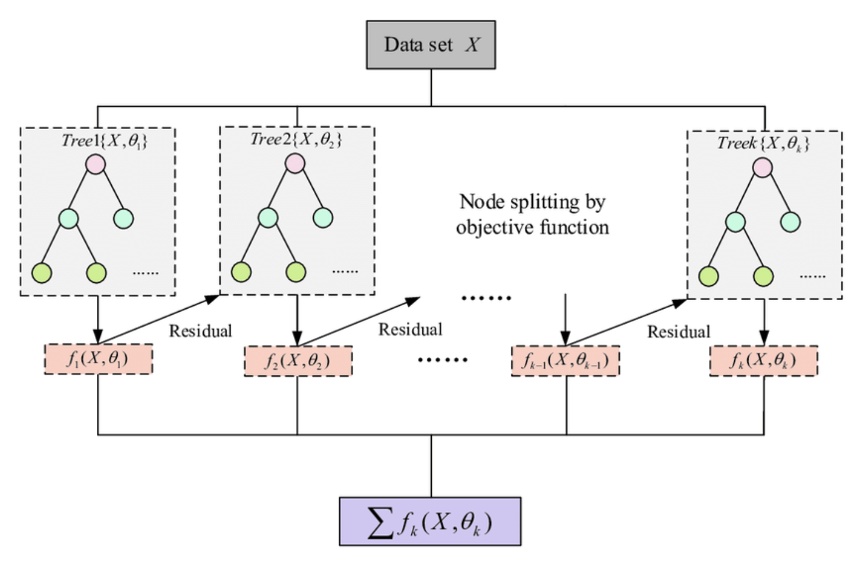
6. Model Training: XGBoost
Advantages:
Structured, high dimensional data
Supports parallel processing
Can train on large datasets
Implementation of Gradient Boosting.
Decision trees created sequentially to learn from previous model’s errors.
Notes:
XGBoost (Extreme Gradient Boosting) is an advanced implementation of the gradient boosting machine learning algorithm. It builds an ensemble of decision trees sequentially, where each tree corrects the errors of the previous ones.

Slide 20
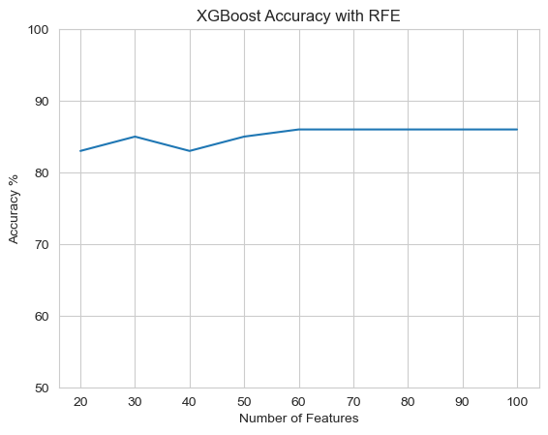
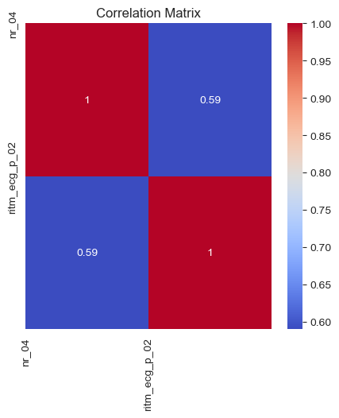
Feature Selection: RFE

Slide 21
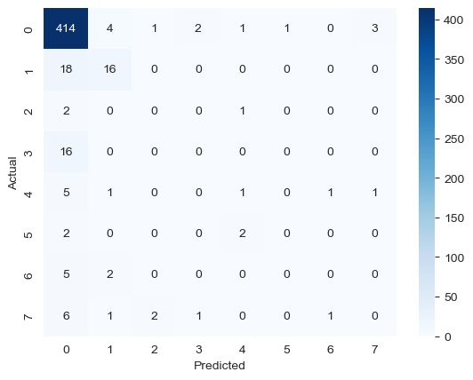
Model Evaluation
precision recall f1-score support
0 0.88 0.97 0.93 426
1 0.67 0.47 0.55 34
2 0.00 0.00 0.00 3
3 0.00 0.00 0.00 16
4 0.20 0.11 0.14 9
5 0.00 0.00 0.00 4
6 0.00 0.00 0.00 7
7 0.00 0.00 0.00 11
accuracy 0.85 510
macro avg 0.22 0.19 0.20 510
weighted avg 0.79 0.85 0.81 510

Slide 22
Conclusion
Lethal Outcome is highly associated with:
Cardiogenic shock, Atrial fibrillation, Paroxysmal SVT
Complete/Incomplete RBBB and LBBB
Fibrinolytic therapy
High sodium levels
Using XGBoost, we can predict with 85% accuracy at the time of admission using the above variables of a lethal outcome.

Slide 23
Next Steps
Collaborate with medical professionals to understand the clinical significance of these features
Try incorporating patient's medical history, lifestyle habits, and other diagnostic tests to see if it can be predicted before the patient reaches hospital.
Improve feature selection - RFE-CV for XGBoost.

Slide 24
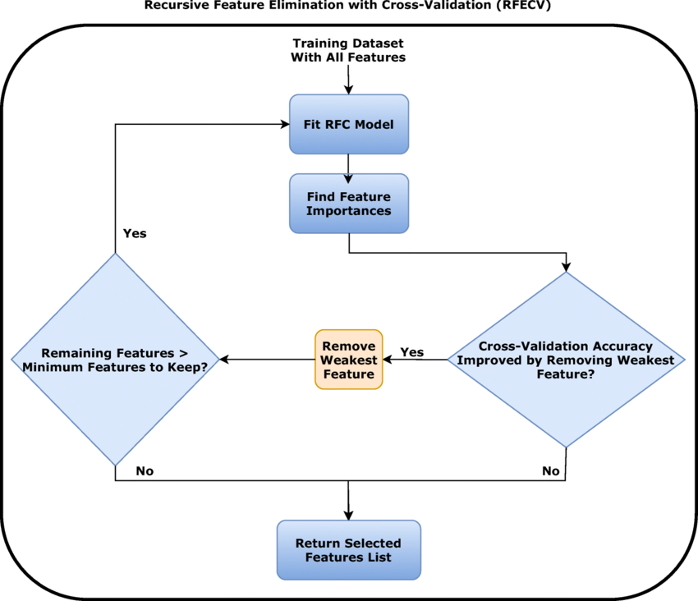
Further Work: Feature Selection with RFE-CV
Purpose: Identifies the best subset of features for the model.
Process: Recursively removes features.
Evaluation: Uses cross-validation to assess model performance.
Goal: Finds the optimal set of features that maximizes predictive accuracy.
Notes:
RFECV is a feature selection technique in machine learning that iteratively removes the least important features from a dataset, evaluates model performance, and uses cross-validation to identify the optimal set of features. Here’s how it works step by step:
Initialization:
Start with all features in the dataset.
Fit the model using all features and evaluate performance using cross-validation.
Feature Ranking:
Rank each feature based on its importance to the model's performance.
For models like RandomForestClassifier, this is based on feature importances. For others, it may use coefficients or weights.
Feature Elimination:
Remove the least important feature(s) from the dataset.
Create a new dataset with the remaining features.
Model Evaluation:
Fit the model using the reduced feature set.
Evaluate performance using cross-validation to see how the removal affects the model.
Termination Condition:
Repeat the elimination and evaluation process until a predefined condition is met, such as a set number of features or no significant improvement in performance.
Final Feature Set Selection:
Select the optimal set of features based on the best performance achieved during cross-validation.
Optional Post-processing:
Optionally, fine-tune model hyperparameters or retrain the model on the entire dataset using the selected features.
RFECV helps in enhancing model performance, reducing overfitting, and improving interpretability by selecting the most relevant features through a systematic and validated approach.

Slide 25
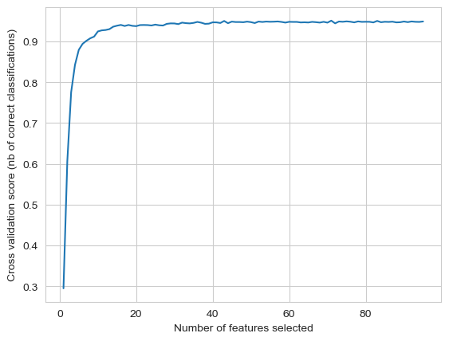
Feature Selection: RFE-CV
CV | Accuracy
5 | 76%
10 | 75%

Slide 26

Model Evaluation
precision recall f1-score support
0 0.88 0.87 0.88 426
1 0.37 0.38 0.38 34
2 0.00 0.00 0.00 3
3 0.17 0.19 0.18 16
4 0.20 0.11 0.14 9
5 0.00 0.00 0.00 4
6 0.00 0.00 0.00 7
7 0.00 0.00 0.00 11
accuracy 0.76 510
macro avg 0.20 0.19 0.20 510
weighted avg 0.77 0.76 0.76 510

Slide 27

T h a n k o u

Slide 28
Q & A

